Slide 1

Zowe 4Q 2022 PI Planning
TSC Focus
Presenters: Jakub Balhar
Notes:
I want to to fit it in 5 minutes.
Alignment?
Containerization
Something to change?
May be missed by the other squads?
V2
Security

Slide 2
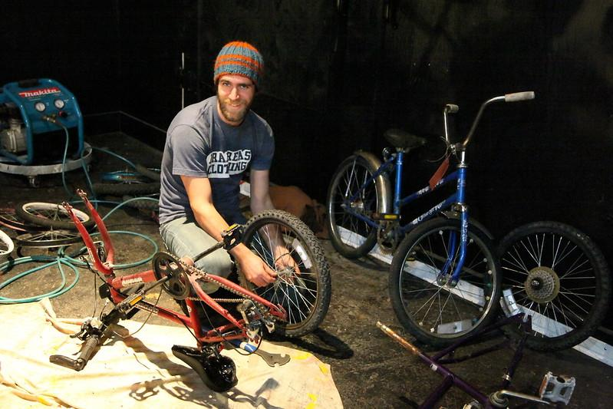
Mission
Simplify the usage of the zOS
Reduce the learning curve for zOS
Attract new people to zOS
Build great community
On a mission to repair bike
Notes:
https://flic.kr/p/2knYMv3

Slide 3
Themes
Notes:
What are the other topics I need to cover here?
Security - All the different approaches to the security
App Store - Improved discoverability of the Zowe extensions
New UI tools - Chatbots
Feedback - Improvement to the feedback loops we are using as Zowe.
Mentorships - Better work with the mentees and potential mentees.
Hybrid environments.
Far away
Artificial Intelligence

Slide 4

Initial Experience
Simplify the first steps up to the production deployment.
Certificate setup on server side
Drive adoption of Zowe
Certifications and courses to help Zowe.
For the first time
Notes:
https://flic.kr/p/2kW6nYL

Slide 5

Security
Dev Sec Ops
Integrating security practices deeper in development
Open SSF Foundation recommendations
Safe Space
Notes:
https://flic.kr/p/2kW6nYL

Slide 6

Feedback
Deeper integration with the users
More tools to get feedback and adapt direction based on it
Let us know. Mail accepted!
Notes:
https://flic.kr/p/2kW6nYL

Slide 7
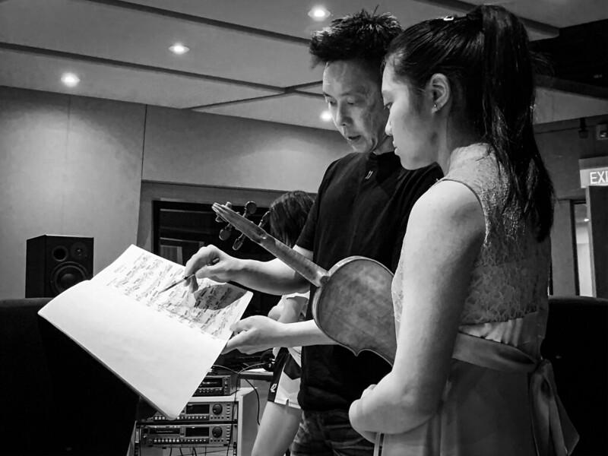
Mentorships
Pipeline for the projects and mentors
Better integration with LF and OMP mentorship programs
This is how the code looks like when played on violin
Notes:
https://flic.kr/p/2kW6nYL

Slide 8

Hybrid Environments
API Economy
Zowe APIs, Vendor APIs, Customers APIs
Complex deployments
Multiple sysplexes + Cloud
Hybrid Cocktail
Notes:
https://flic.kr/p/2kW6nYL

Slide 9
Policies

Slide 10

Issue Handling
Lifecycle
Time to response
Types of issues
Bugs, Enhancements, Questions
Priority, Severity
Long overdue issue

Slide 11

Testing
Unit testing
Functional Testing
Acceptance Testing
Penetration Testing
Codify Best Practices
Load Testing

Slide 12
Plans

Slide 13

Releases
Intellij Explorer GA
Zowe Chat Technical Preview
Communicate

Slide 14

Education and certification
First course
Explore the options for interactive courses
This is the right way, I am telling you.

Slide 15
State of the issues

Slide 16
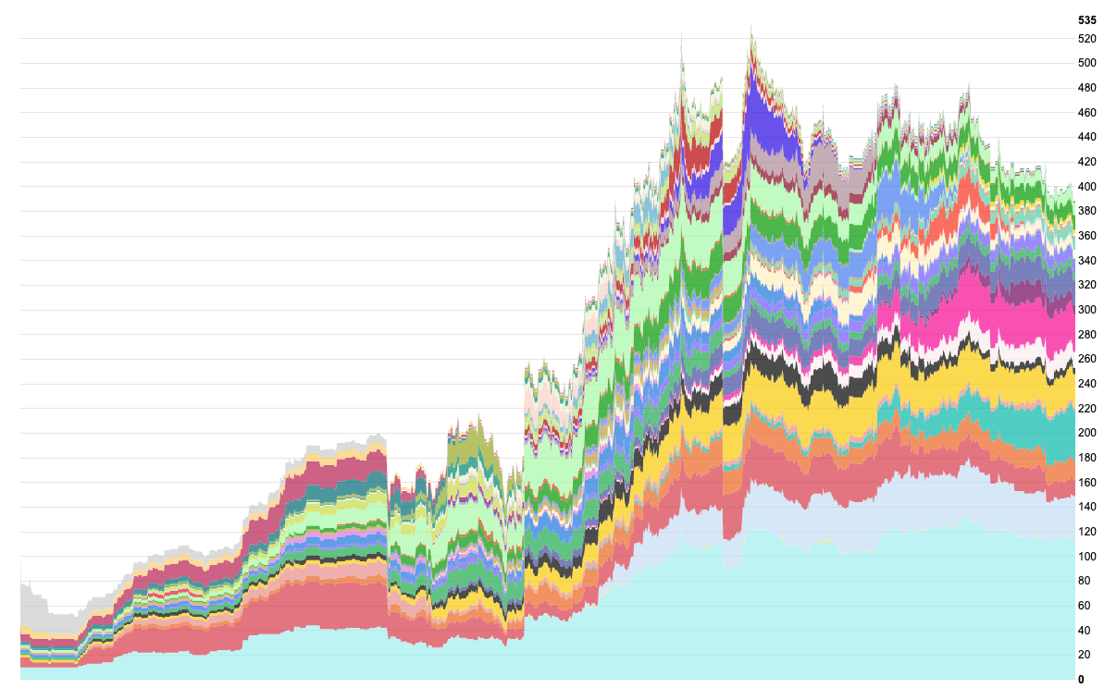
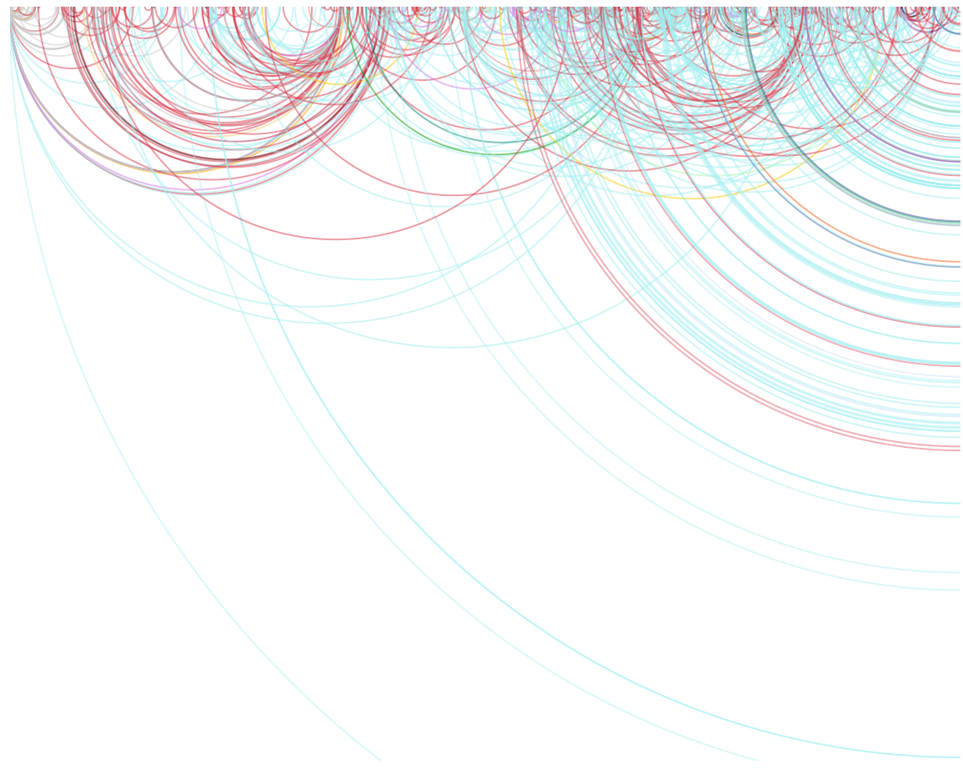
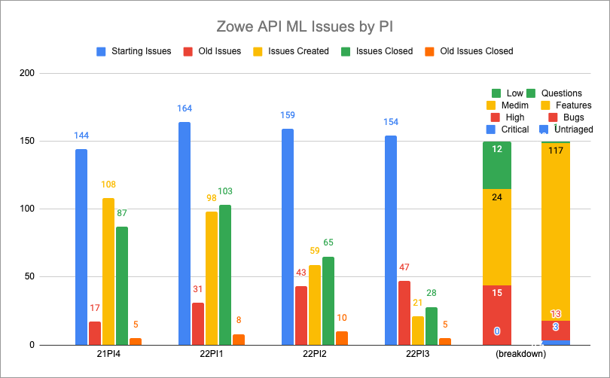
API Mediation Layer

Slide 17
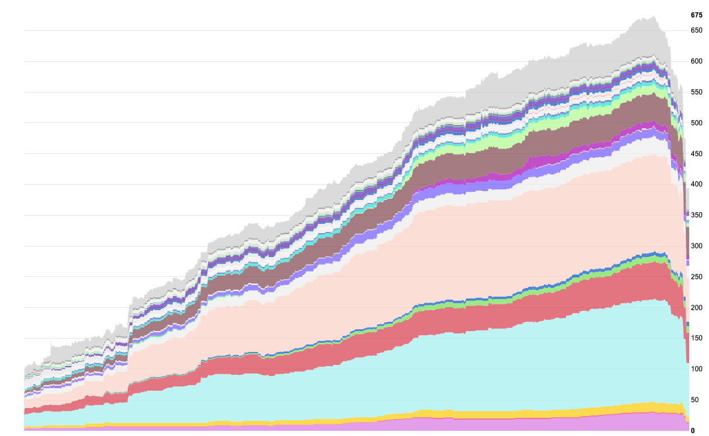
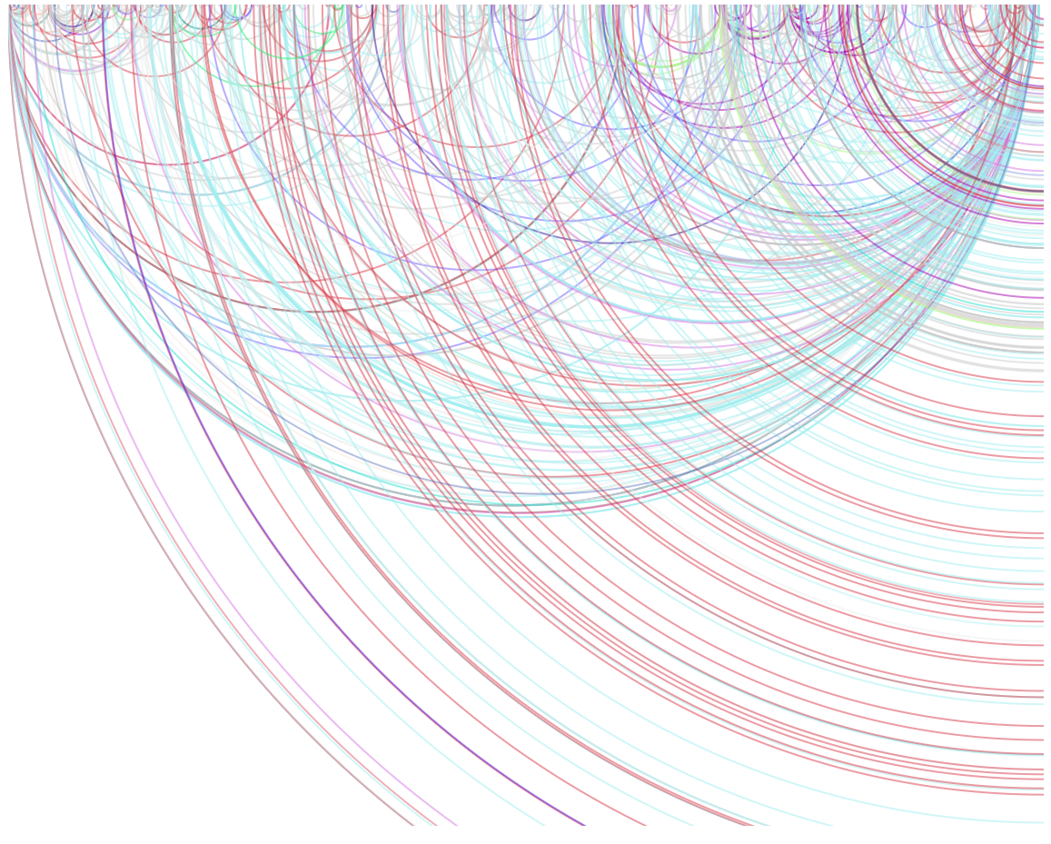
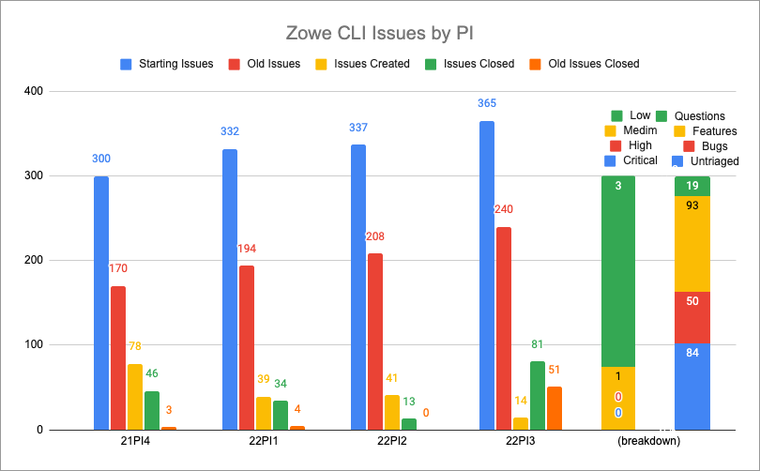
CLI

Slide 18
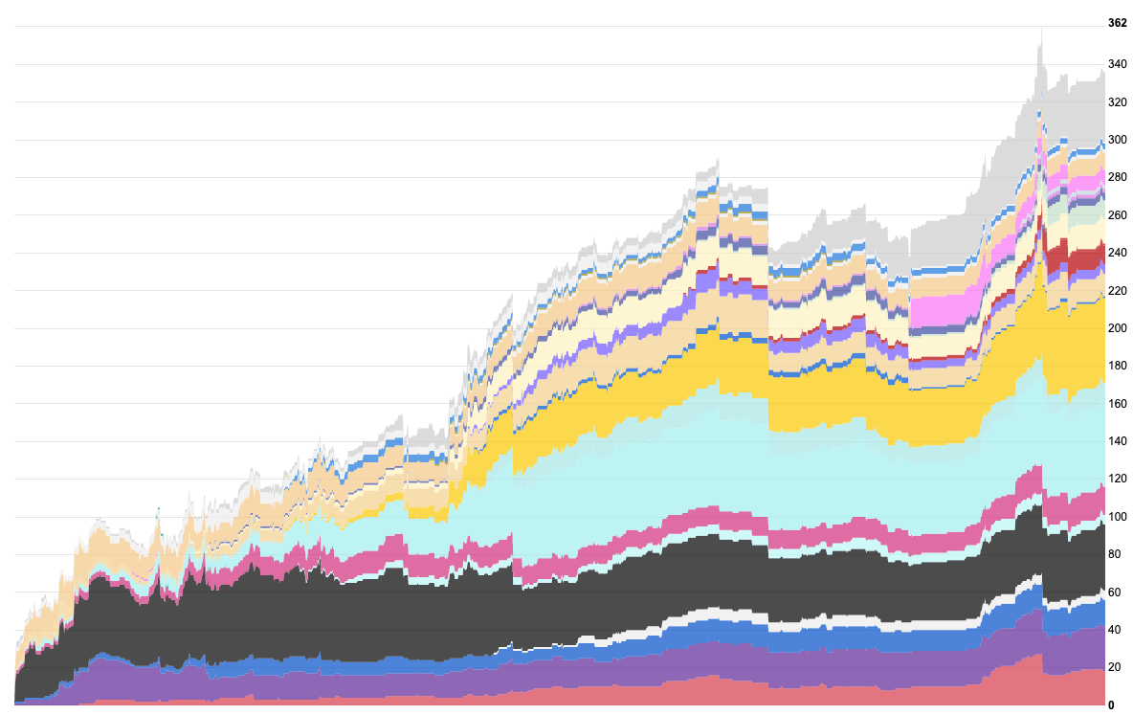
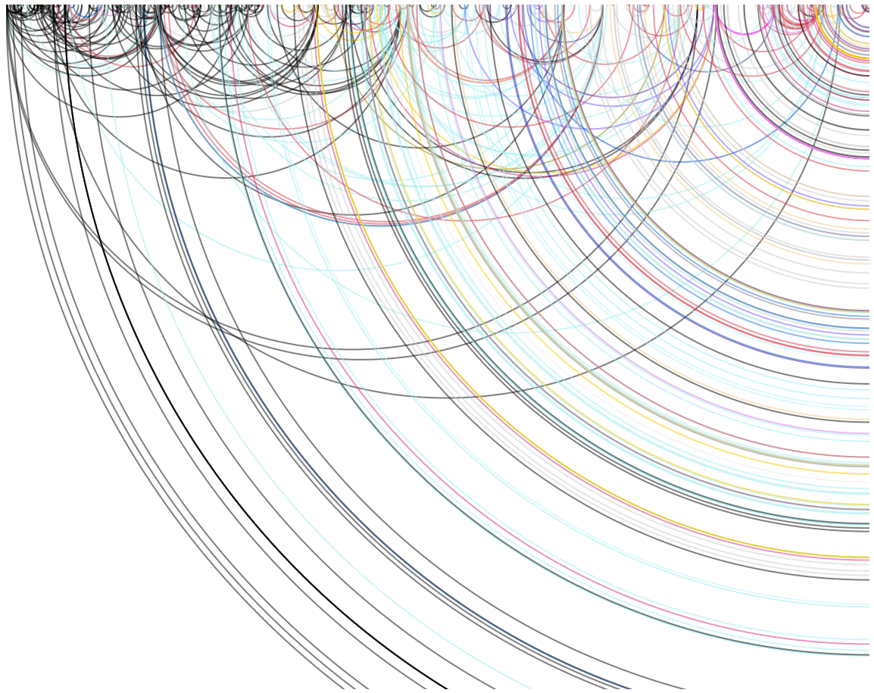
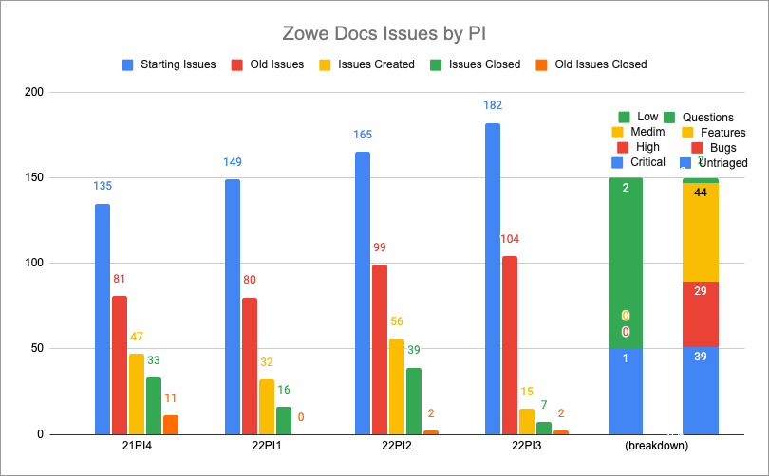
Docs

Slide 19
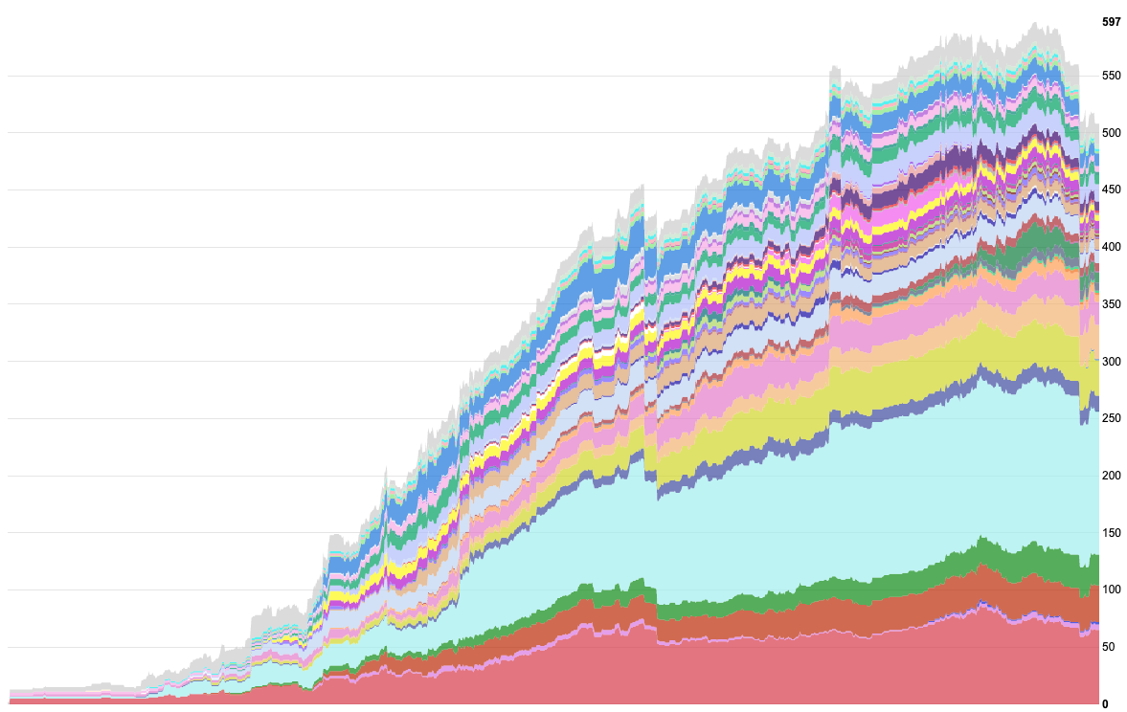

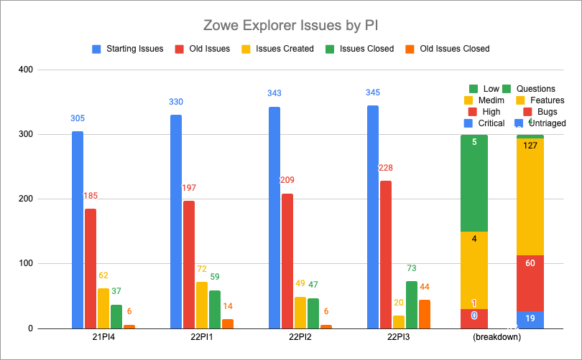
Explorers - VSCode

Slide 20
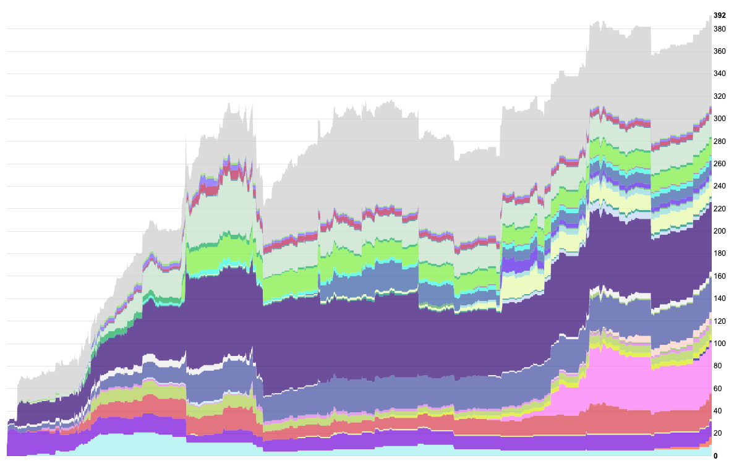
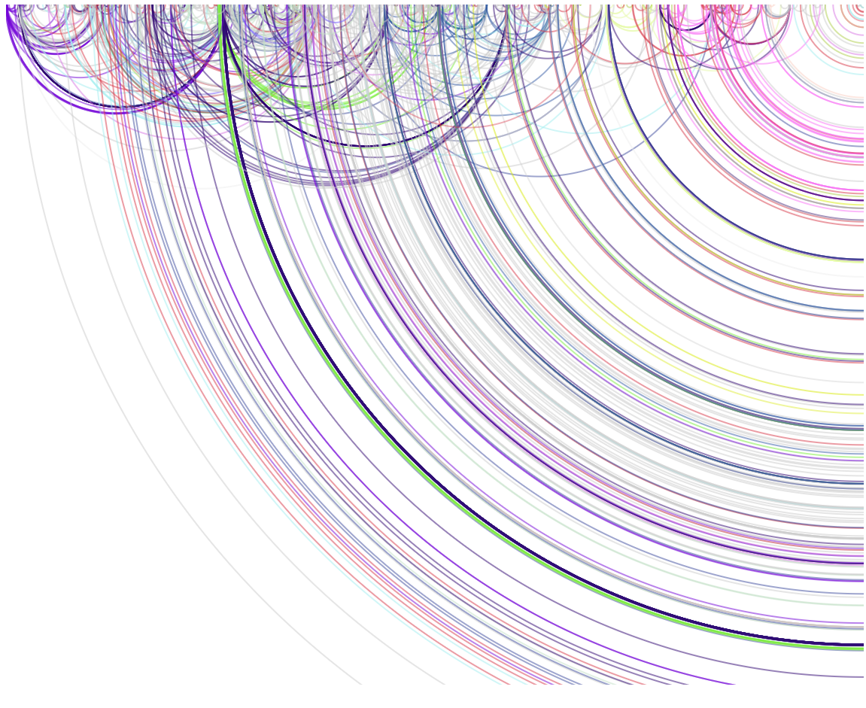
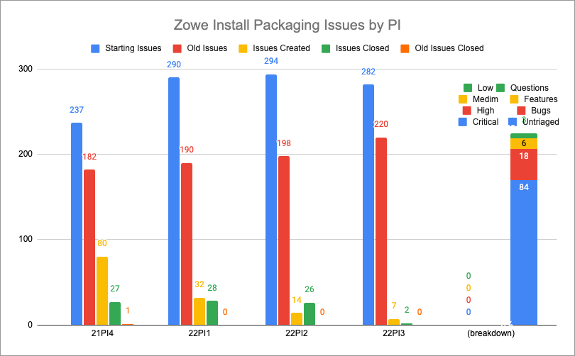
Installation and packaging

Slide 21
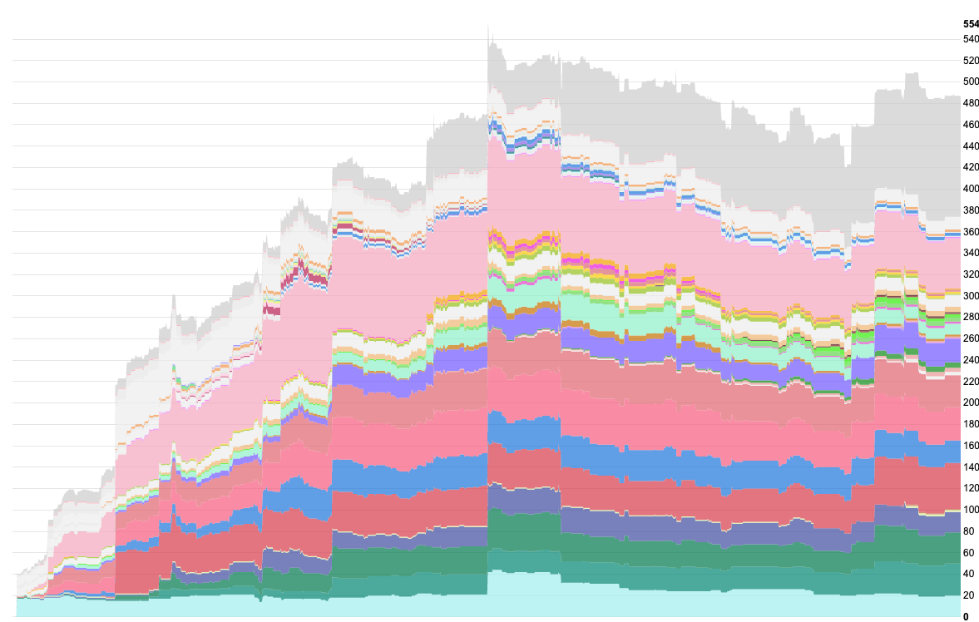
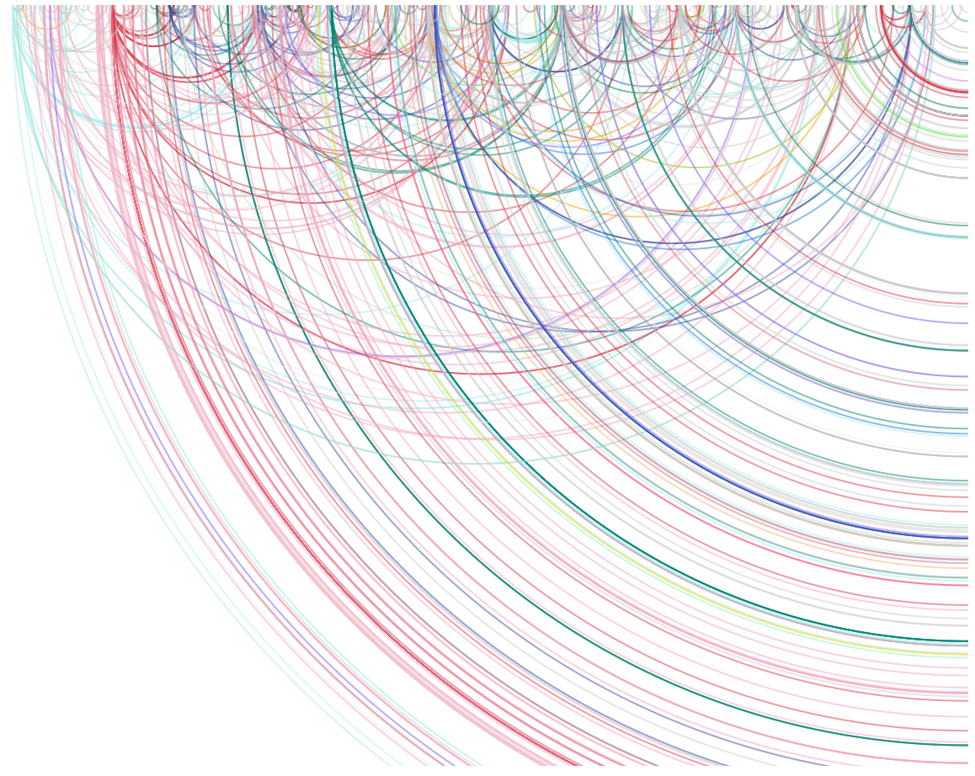
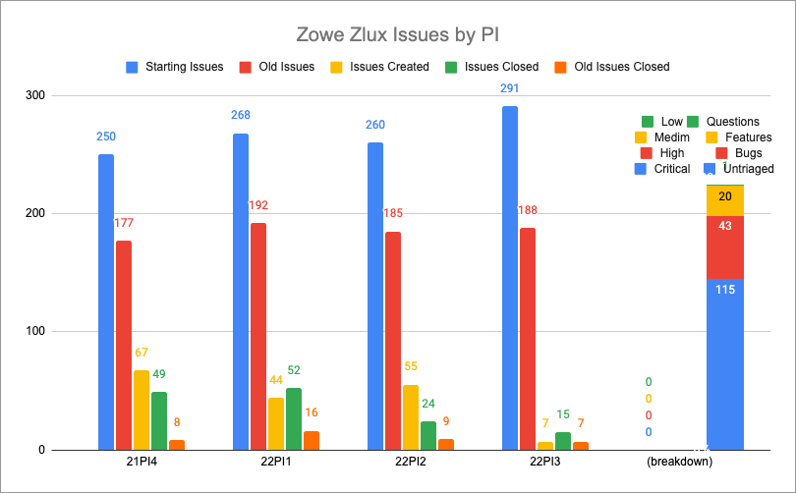
ZLUX

Slide 22
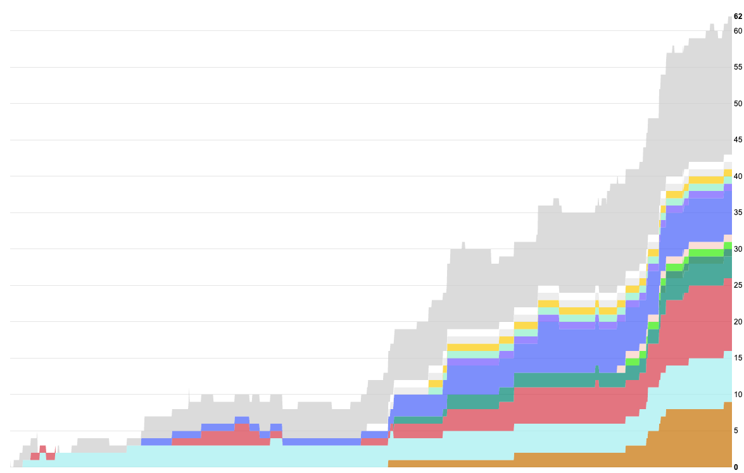
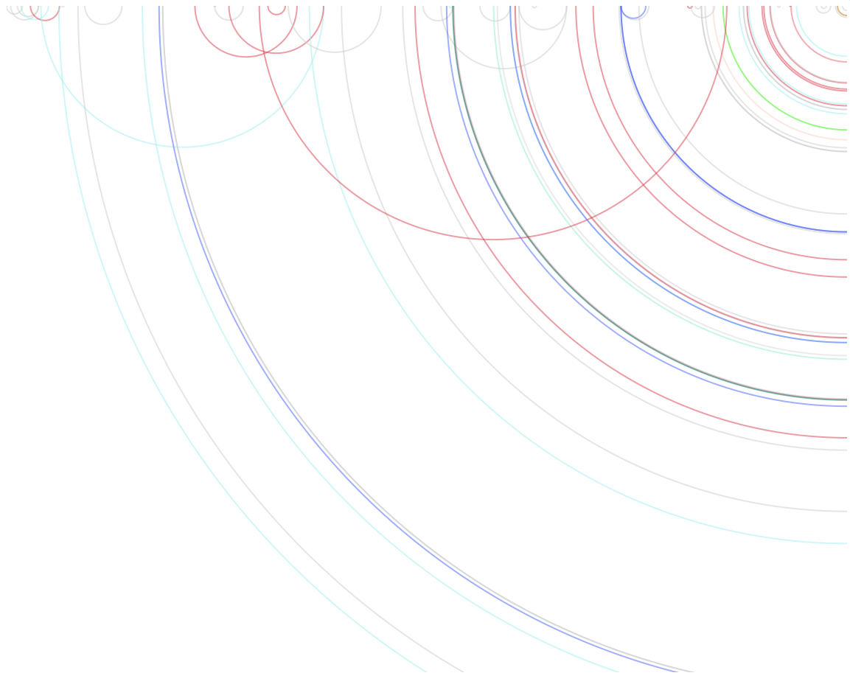
ZSS

Slide 23
State of the community

Slide 24
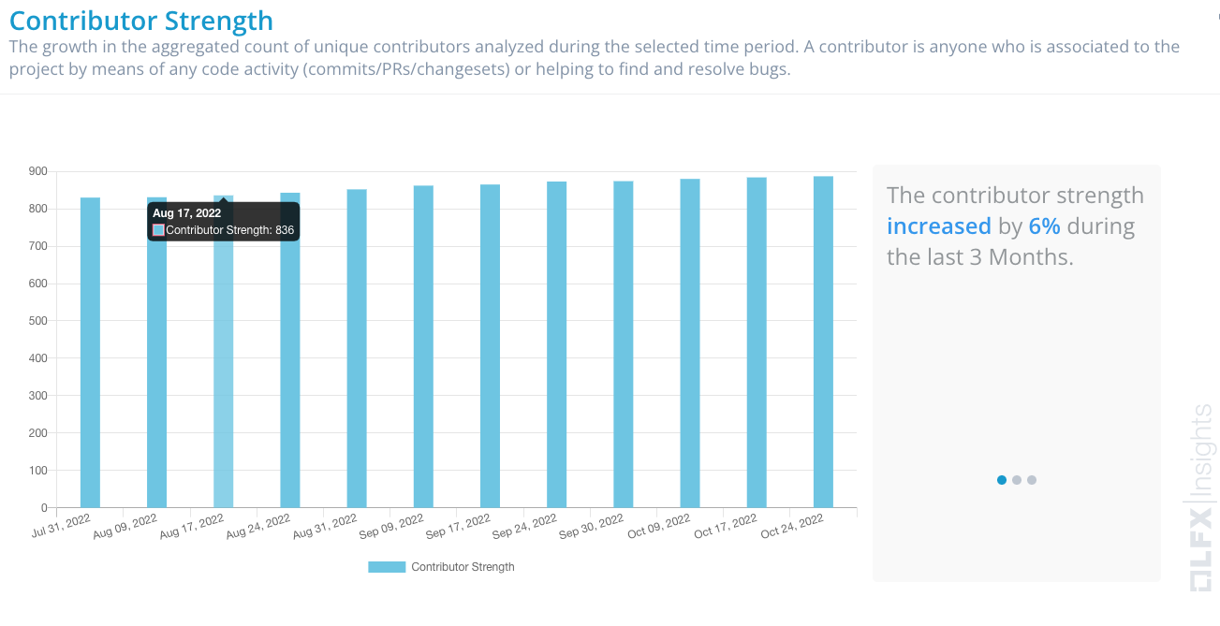
Contributors

Slide 25
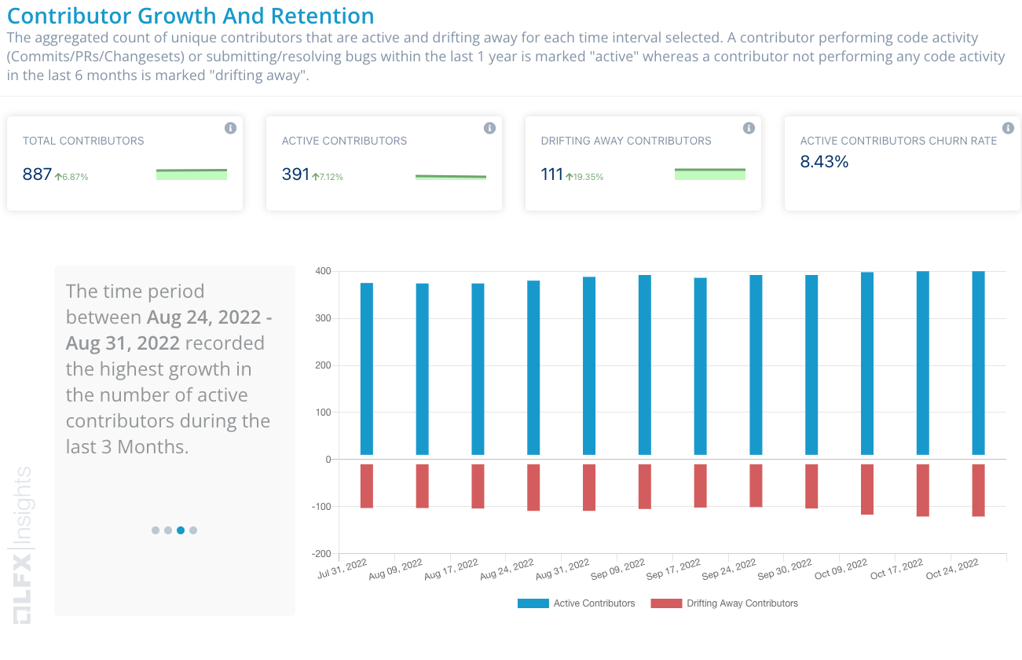
Explorers

Slide 26
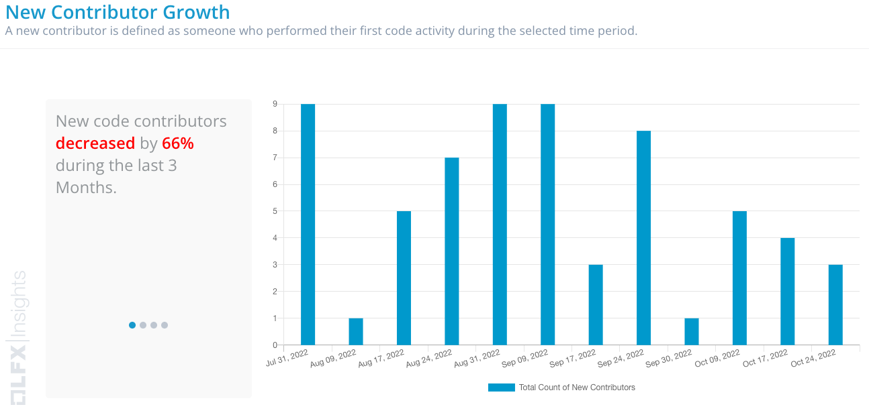
New Contributors

Slide 27
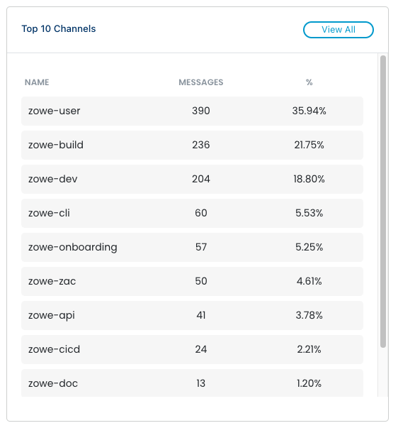
Slack

Slide 28
State of the code

Slide 29
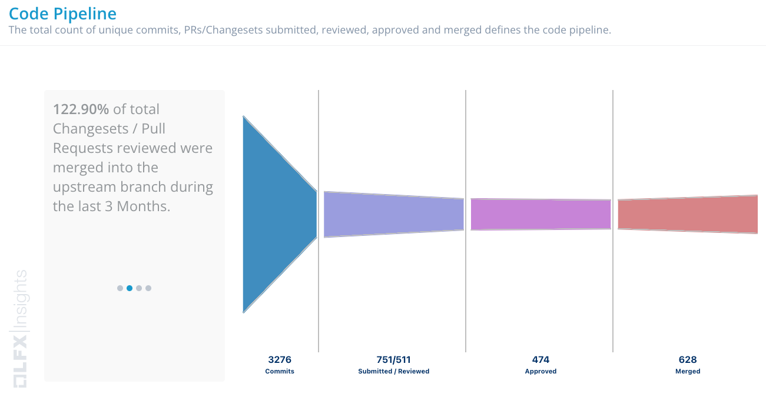
Code Pipeline

Slide 30
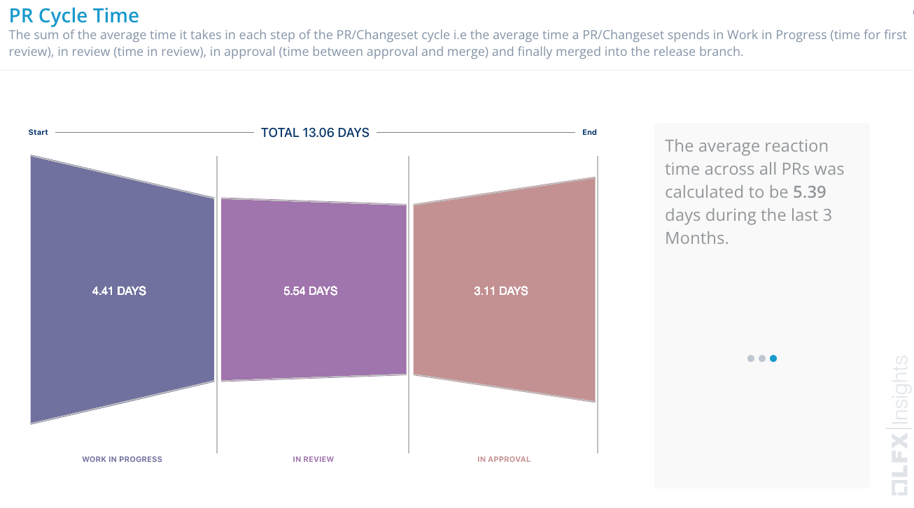
PR Cycle Time

